Slide 1
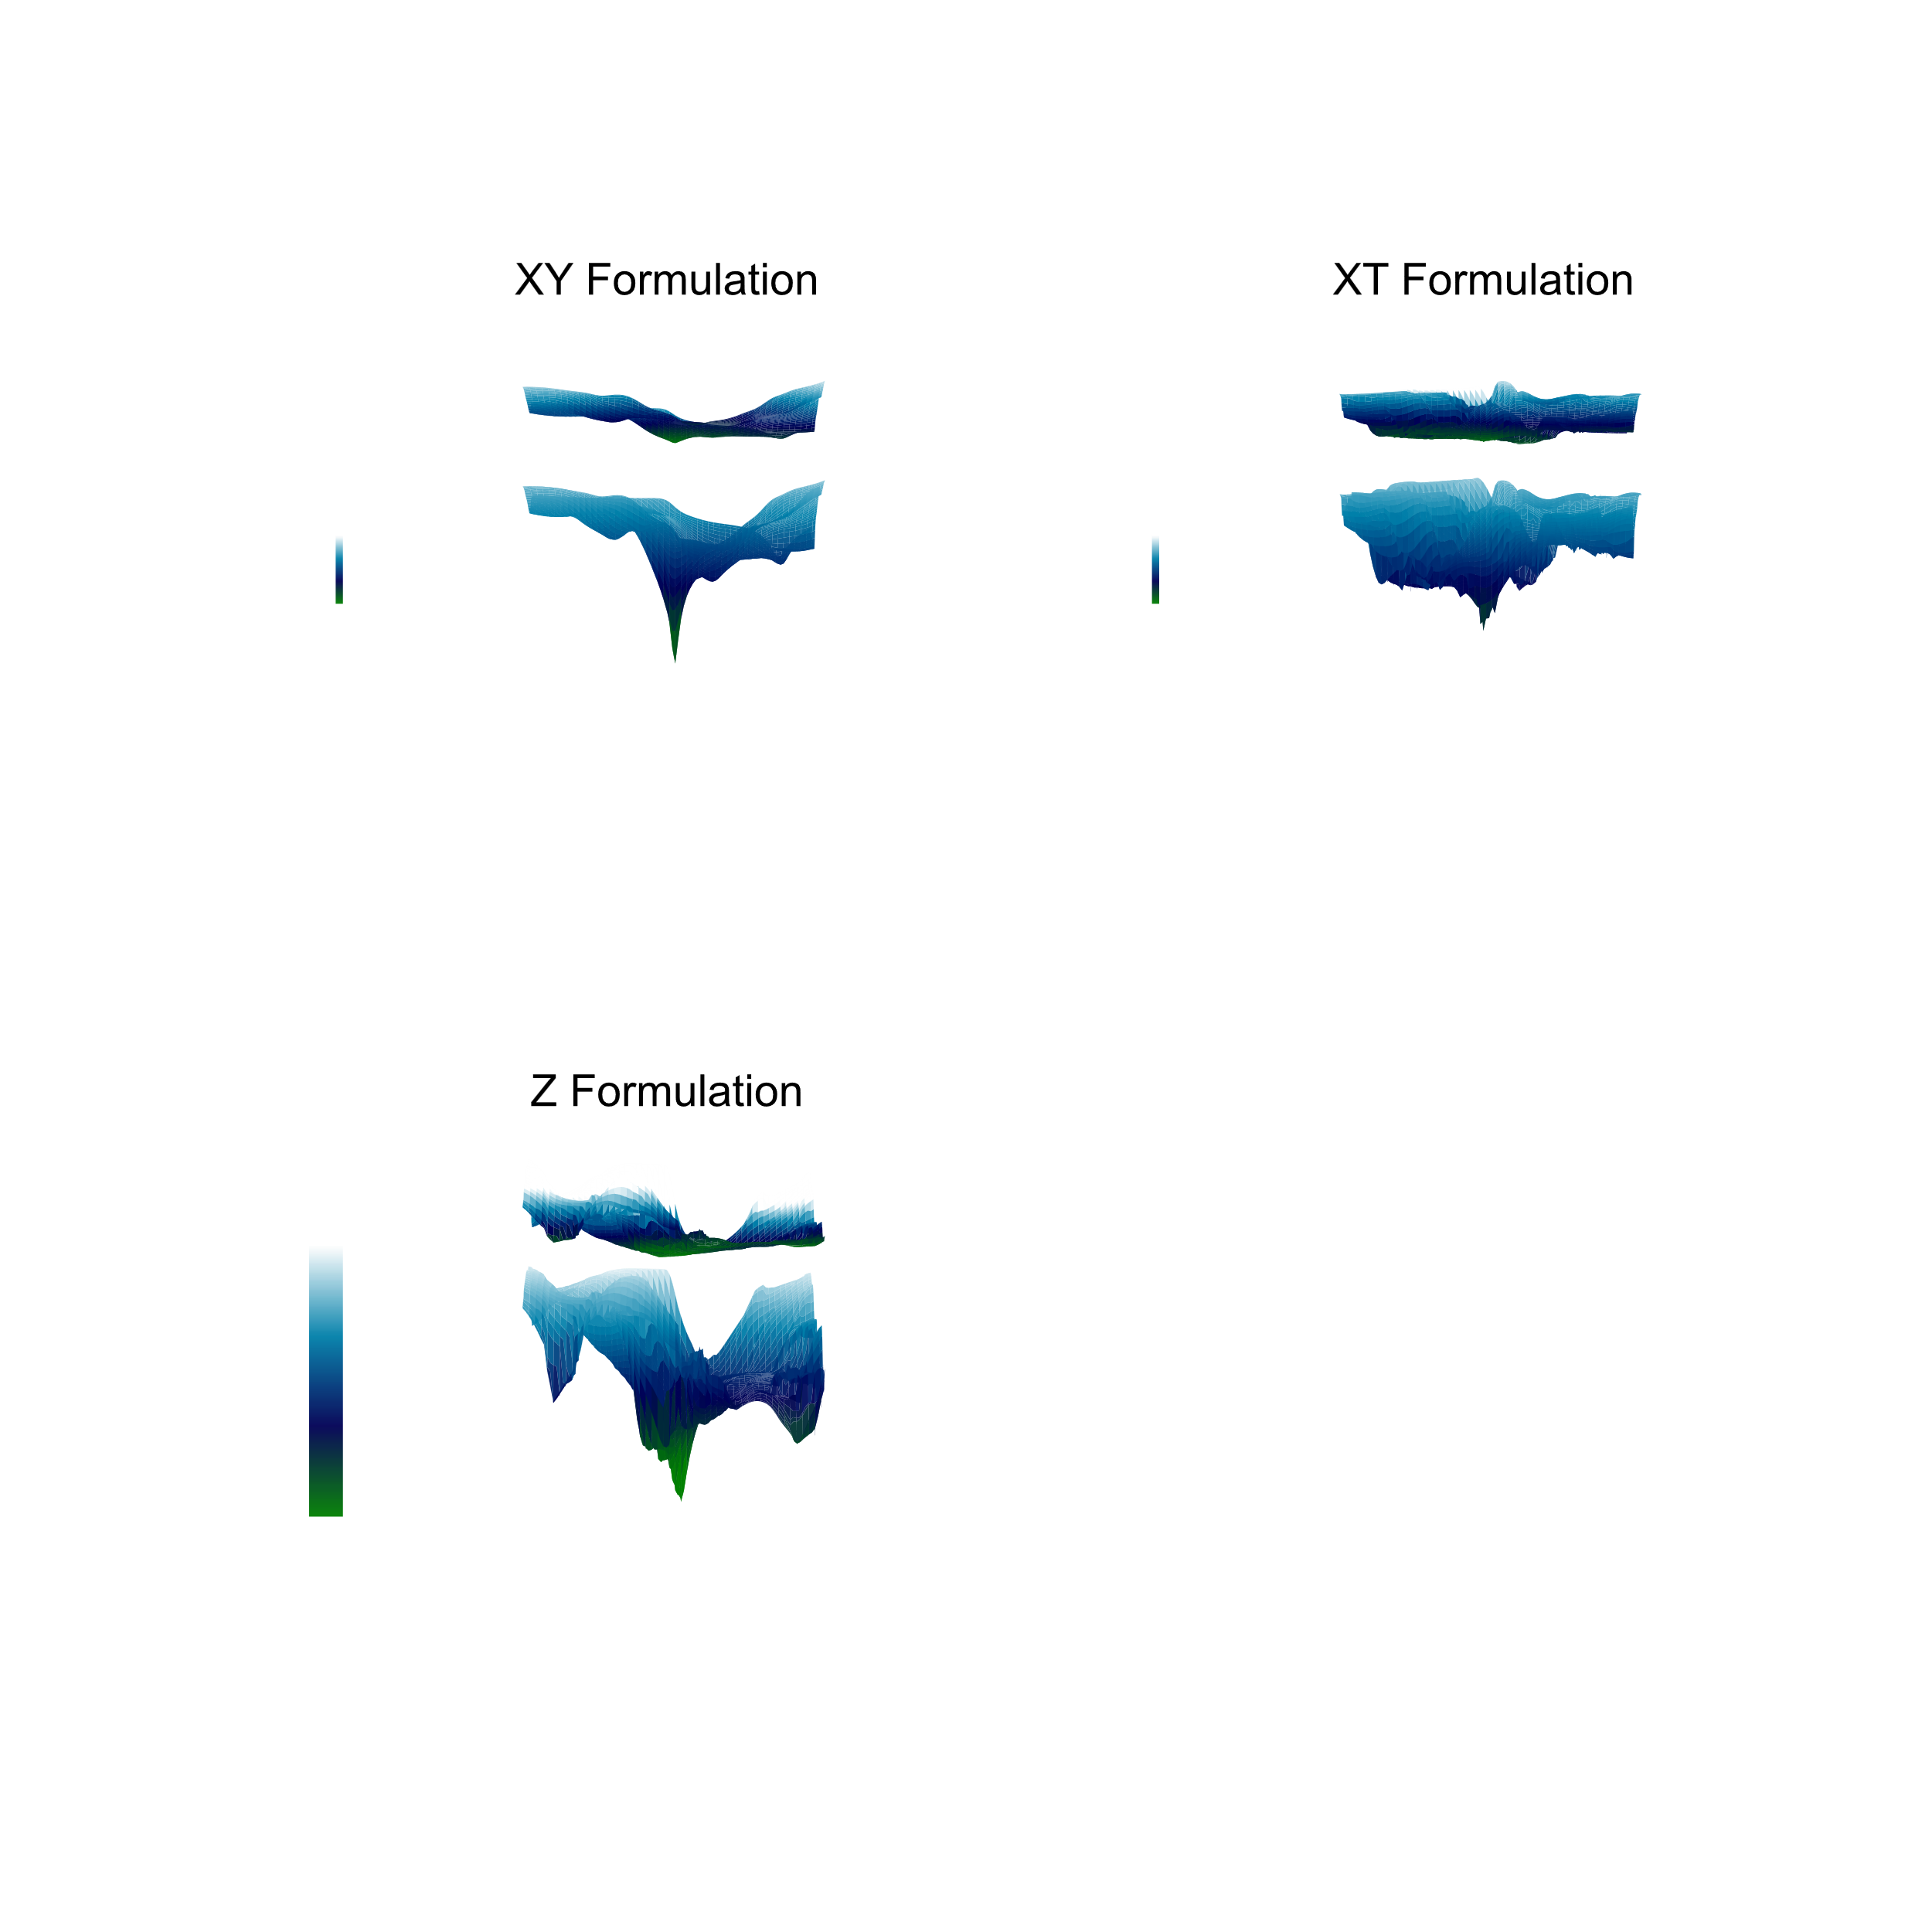


Scientific Machine Learning (SciML) for Solving PDEs
(Case Studies: two-phase flow in porous media)
University of Stavanger (Jan 2025)

Slide 2
Contents
Day 1
Part 1: Scientific Machine Learning (SciML): Introduction and Recent Advances
Part 2: Physics-Informed Neural Networks (PINNs)
Day 2
Part 3: A Case Study: Inverse Calculations on Spontaneous Imbibition Experiments
Part 4: Hands-on Experience with PINNs and Neural Operators
University of Campinas (Nov. 2024)

Slide 3
References
AI in the Sciences and Engineering (2024), ETH Zurich, CAMLab
https://camlab.ethz.ch/teaching/ai-in-the-sciences-and-engineering-2024.html
Deep Learning for Scientists and Engineers, by George Em Karniadakis, Khemraj Shukla, Summer 2023 at KTH Stockholm
Steve Brunton YouTube channel. https://www.youtube.com/@Eigensteve
https://sciml.tamids.tamu.edu/ecen-689-scientific-machine-learning-spring-2024/
…

Slide 4
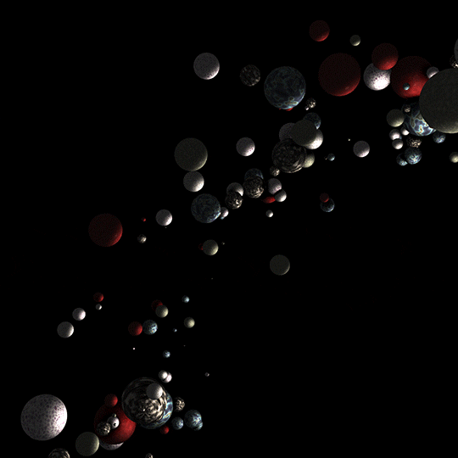
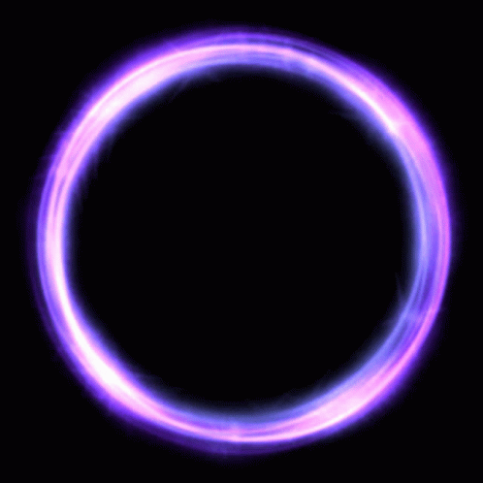
Data Driven Approaches
Physics-informed AI
Physics-informed Neural Networks (PINNs)
No Data
All Physics
Some Data
Some Physics
Big Data
No Physics
Data
Physics
Karniadakis et al., 2021

Slide 5
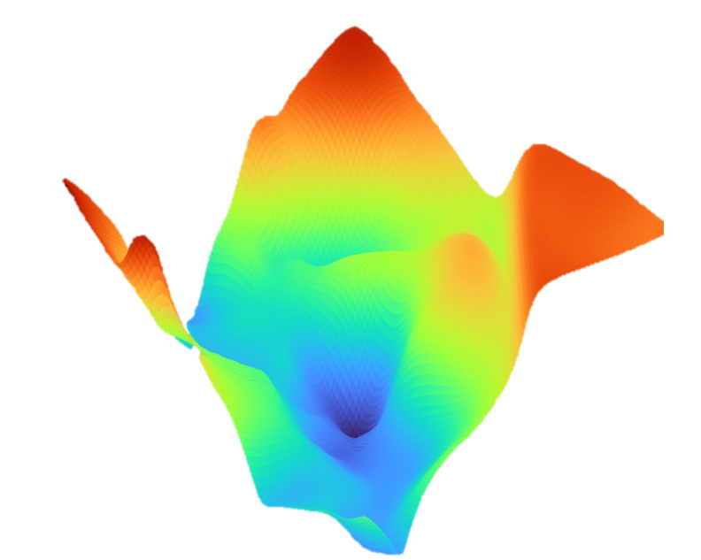


Physics Informed Neural Networks
First Introduced by Raissi et al. (2019)
Reliable for mixed data types
Flexible to noisy/incomplete data
Quicker history matching
More reliable sensitivity analysis
Live interpretation with low supervision
Optimization
Machine Learning
Forward Simulation
History Matching
Physics
Uncertainty quantification
Data-driven modeling
Numerical Methods

Slide 6
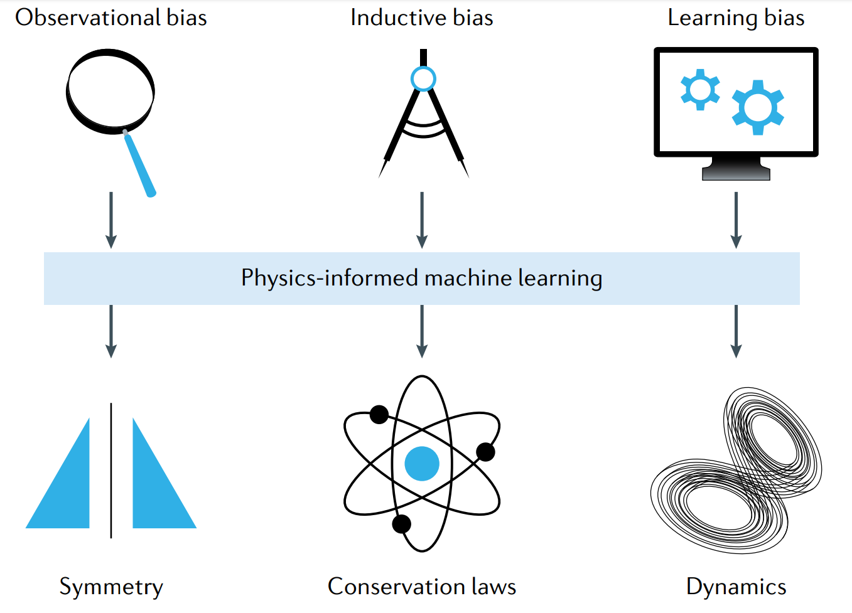
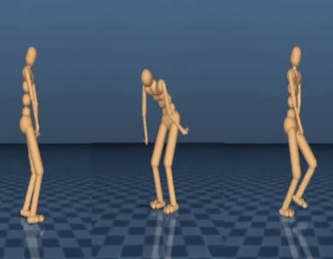
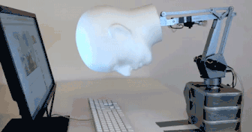
Physics Informed Machine Learning
Karniadakis et al., 2021

Slide 7
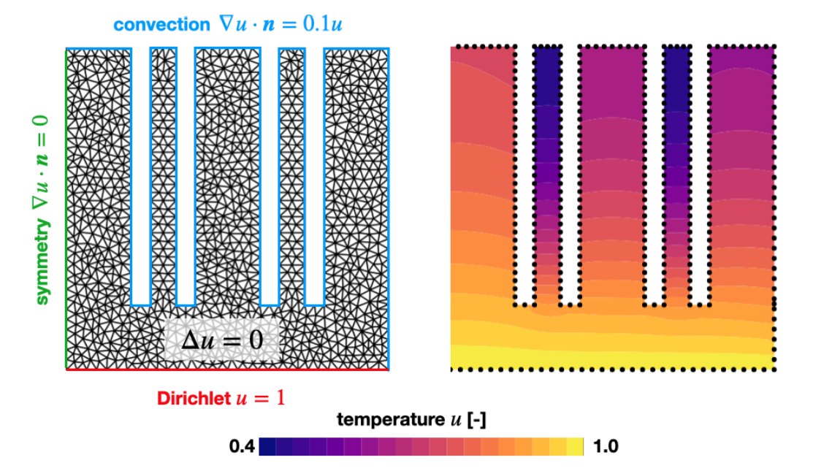
Example: A Forward Problem
Given boundary conditions and the heat equation, find the temperature inside the heat sink.

Slide 8
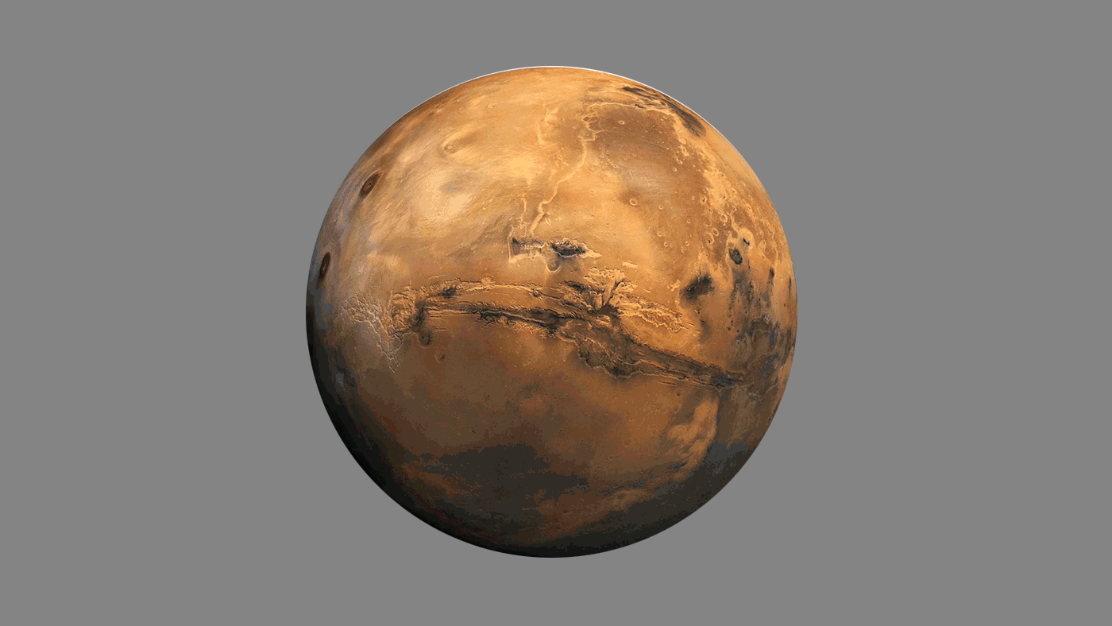

Inverse Problems
KEY CHARACTERISTICS
Ill-Posedness
Nonlinearity
Noisy Data
APPLICATIONS
Medical Imaging
Geophysics
Engineering

Slide 9

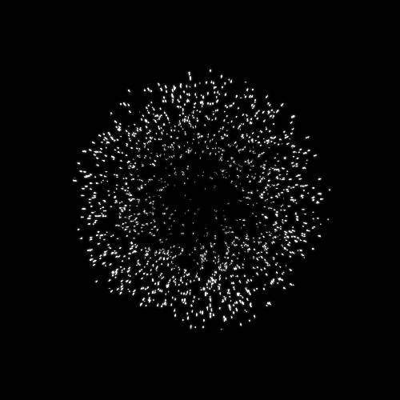
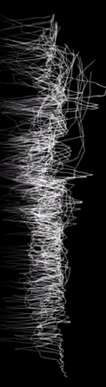
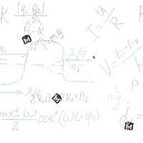
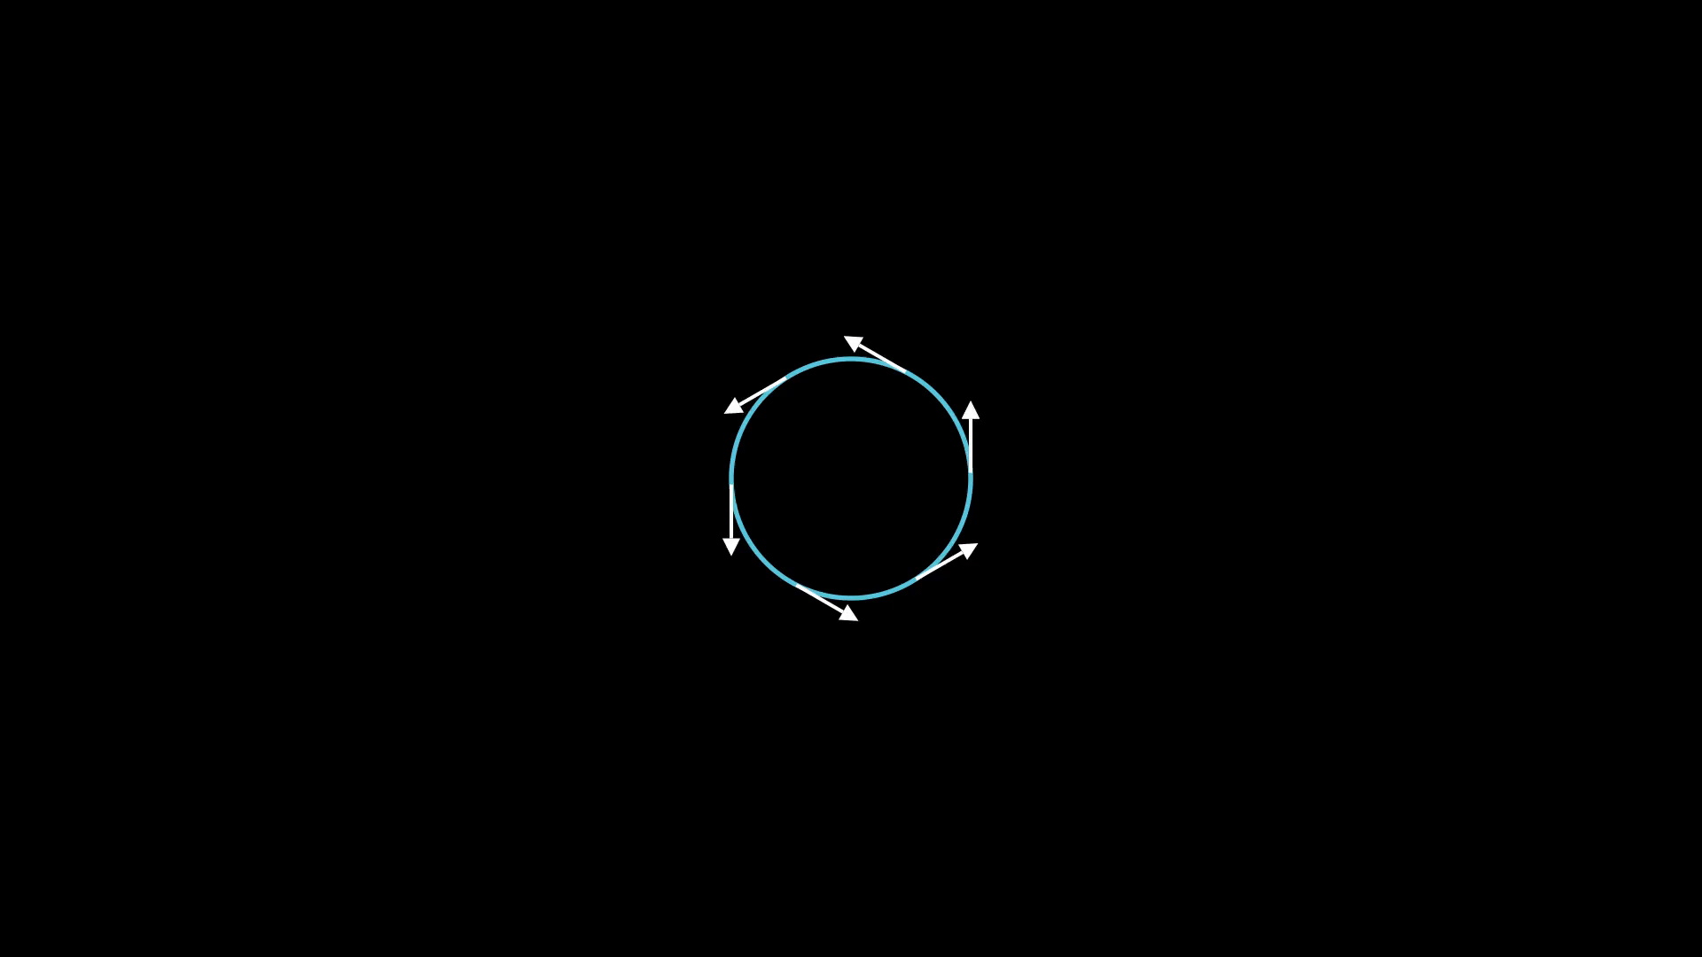


Multi-Fidelity Observations Multi-Physics
u
r
Domain
Knowledge
Multi-Fidelity
Data

Slide 10
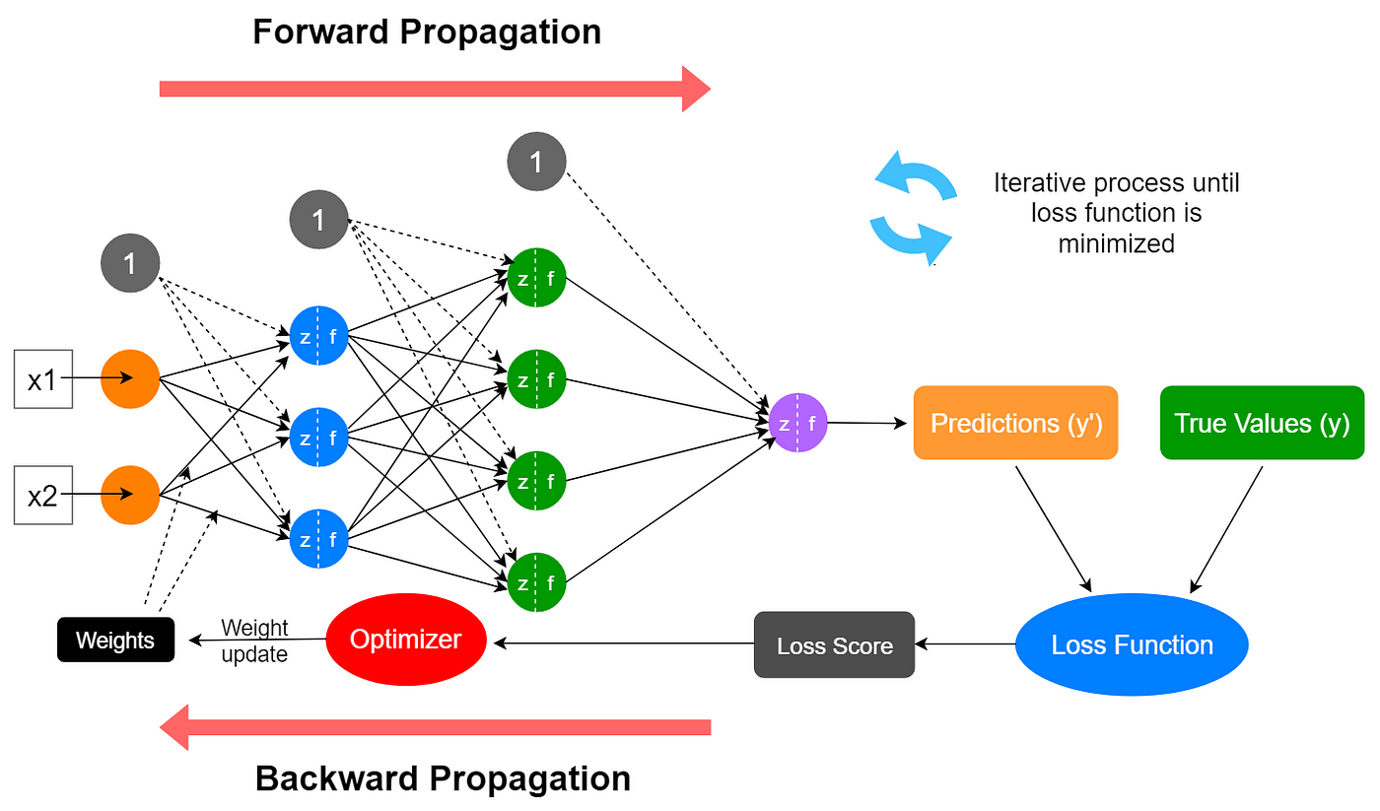
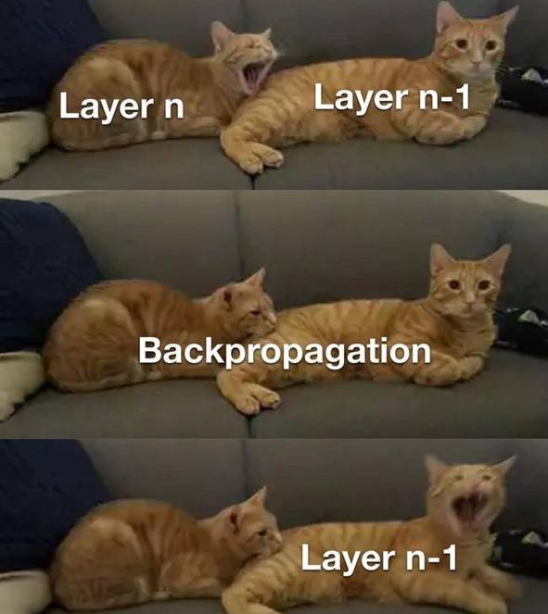
Training Process

Slide 11
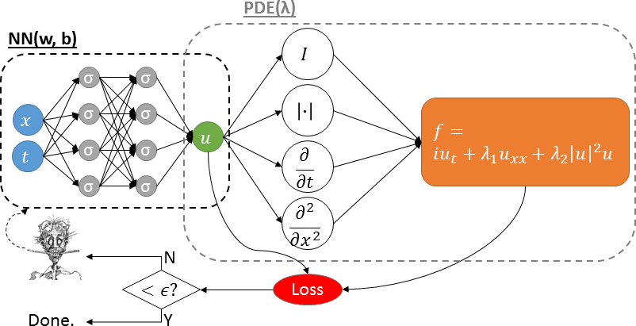
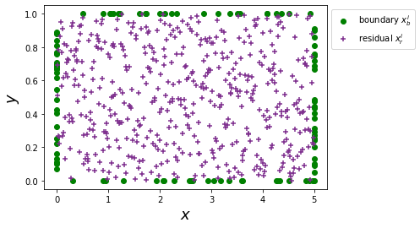

What is a PINNs? Physics-Informed Neural Networks
$$u=ℱ(x,t,λ)$$
Minimize:
Notes:
PINNs is a simple concept that is explained here. On the left., we have the data NN, corresponding to supervised learning; on the right we have an extension of the NN corresponding to parametrized physics, here
The parametrized NL Scrodedinger’s equation. Here “f” is the residual that we aim to minimize (to zero) and hence the second term in the loss function, so we have the data loss and the physics loss. How we weigh them is very important as we will discuss soon. We note that the differential operators are obtained via Adm hence avoiding the “tyrrany of mesg generation” – this is a truly meshless method.
The Schrödinger equation is a cornerstone of quantum mechanics and is used to study a wide range of physical phenomena, such as the behavior of atoms and molecules, the properties of materials, and the behavior of subatomic particles.

Slide 12
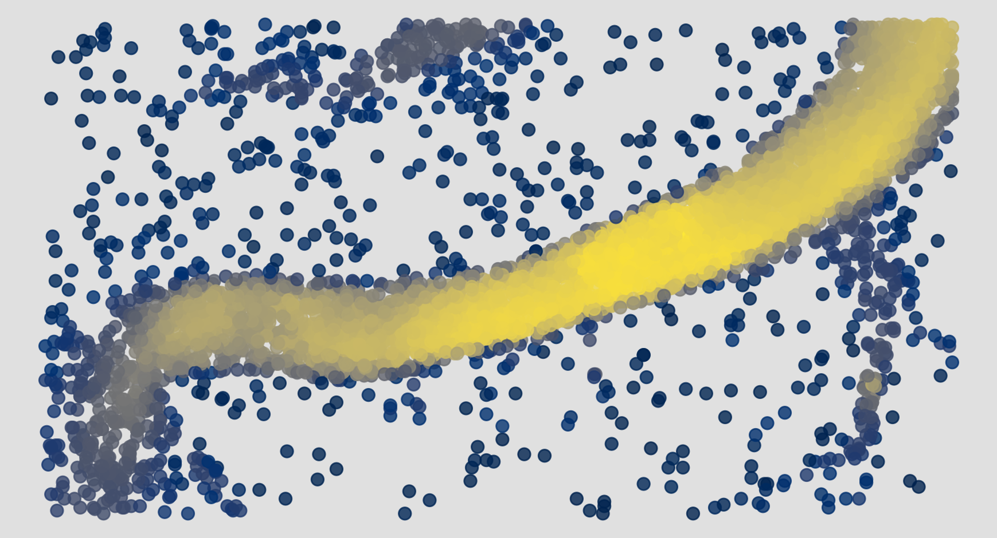
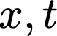

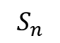
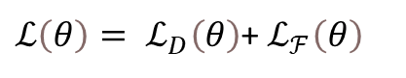

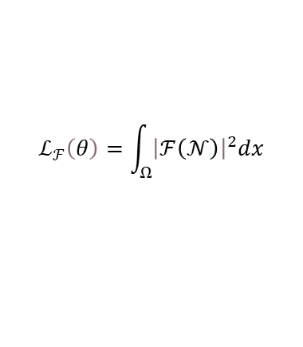
Physics Informed Neural Networks(PINNs)
Are a type of universal function approximators that can embed the knowledge of any physical laws
The outputs are governed by partial differential equations (PDEs);
Data loss
Neural network, fθ
Time
Loss Functions
Input
…
$$S_{n}$$
${ℒ\left(θ\right)= ℒ}_{D}\left(θ\right)$+ $ℒ_{ℱ}\left(θ\right)$
…
…
Physics losses
…
$$ℱ=∂_{t}S_{n}−∂_{x}^{2}S_{n}$$
$$ℒ_{ℱ}\left(θ\right)=\int_{Ω}{{\left|ℱ\left(𝒩\right)\right|}^{2}dx}$$
Riel et al., (2021)

Slide 13
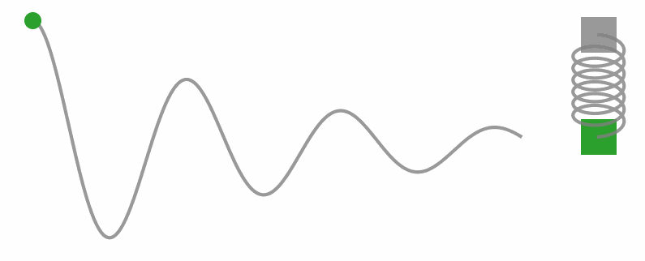
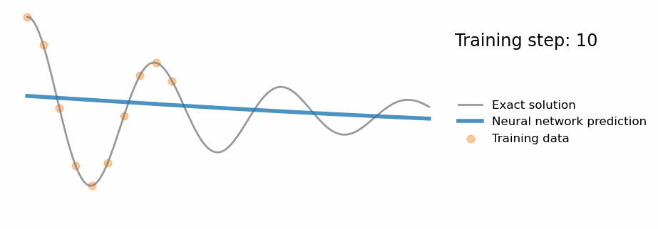
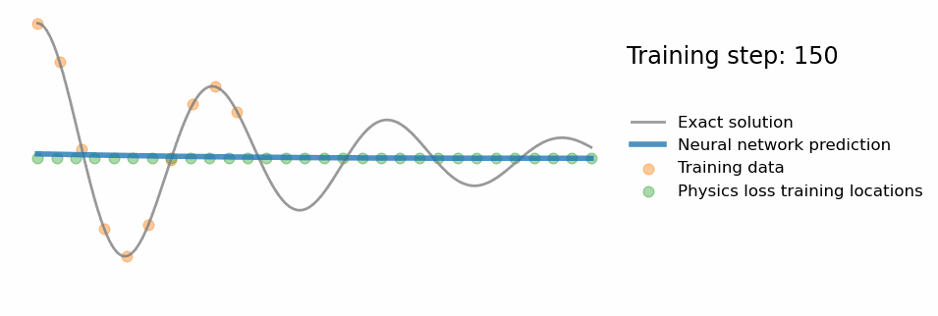
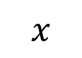
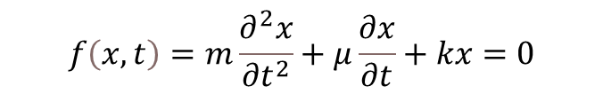
Harmonic-Oscillator
The dynamics of movements in mechanical oscillators such as spring or pendulum
Only Data
$$f\left(x,t\right)=m\frac{∂^{2}x}{{∂t}^{2}}+μ\frac{∂x}{∂t}+kx=0$$
Data + Physics
t
…
$$x$$
…
…
…
Reference: https://github.com/benmoseley/harmonic-oscillator-pinn

Slide 14
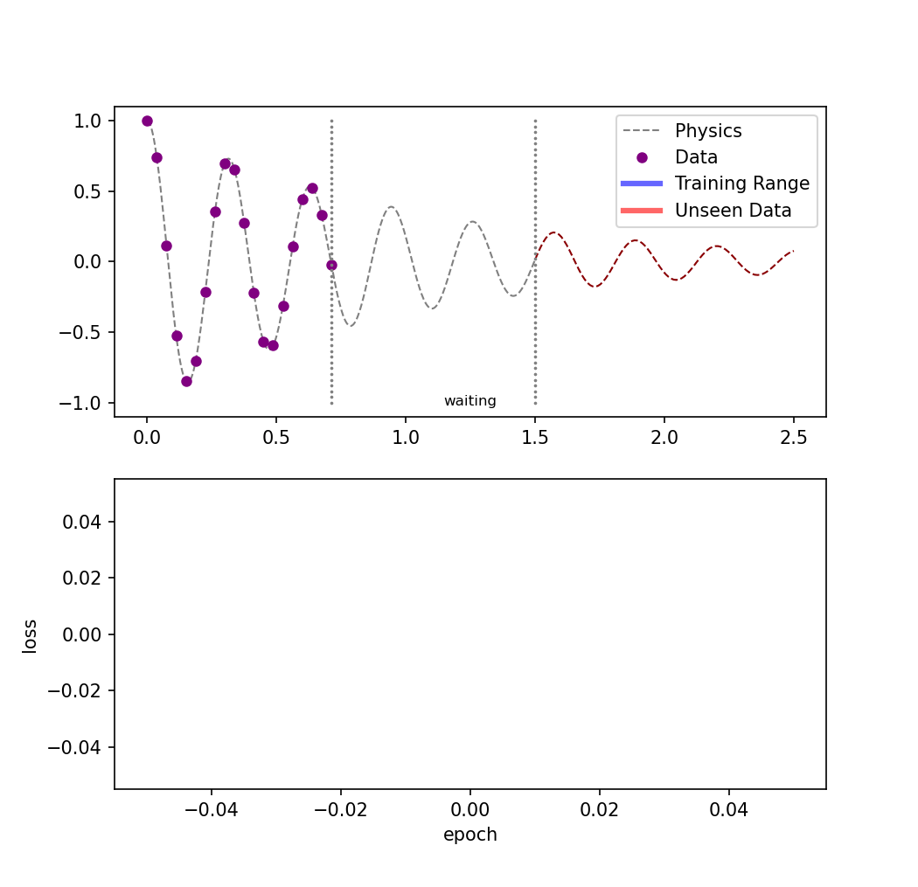
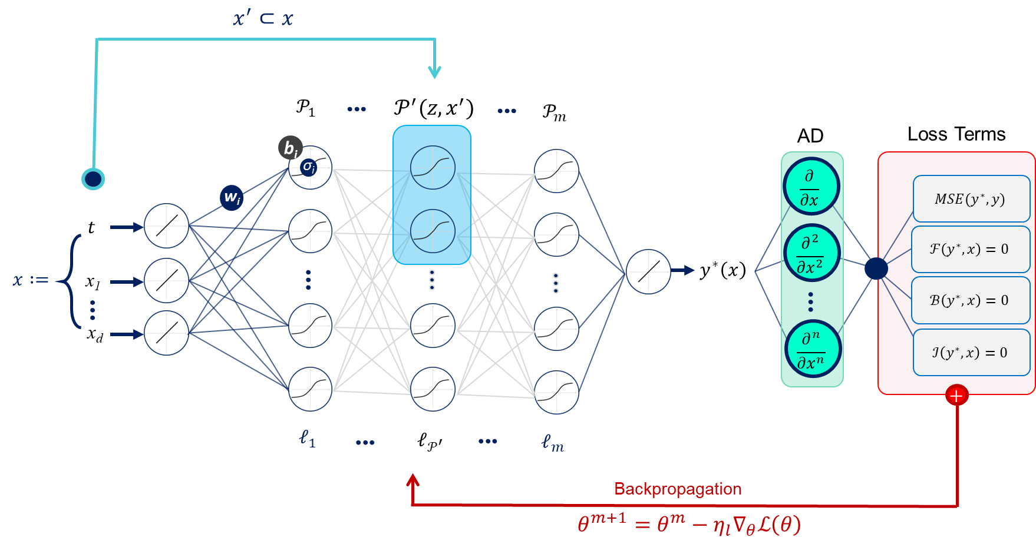
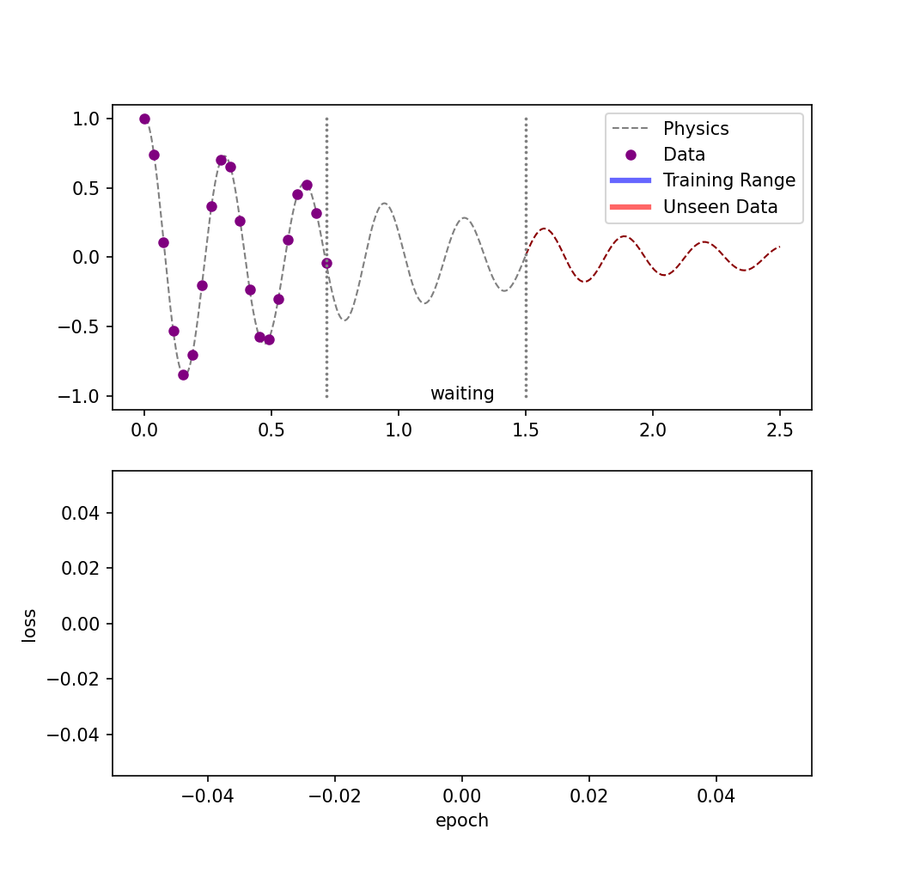
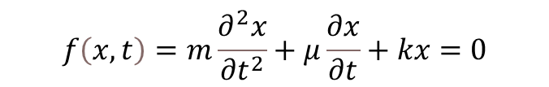
Harmonic-Oscillator Activation Functions
The dynamics of movements in mechanical oscillators such as spring or pendulum
$$f\left(x,t\right)=m\frac{∂^{2}x}{{∂t}^{2}}+μ\frac{∂x}{∂t}+kx=0$$
Abbasi and Andersen (2022) – Under Review

Slide 15
How do we calculate PDE residual loss?
R := u_{t}+ qu_{x}=0
_{at t=0: u=0; at x=0: u=1}
u = model(x, t)
du_dt= torch.autograd.grad(u, t)[0]
1
du_dx= torch.autograd.grad(u, x)[0]
2
residual = du_dt + q * du_dx
3
loss_physics = torch.mean(abs(residual))
ui = model(x, t=0) >> loss_ic = torch.mean(abs(ui – 0))
ub = model(x=0, t) >> loss_bc = torch.mean(abs(ub – 1))
loss_total = loss_physics + loss_ic + loss_bc

Slide 16
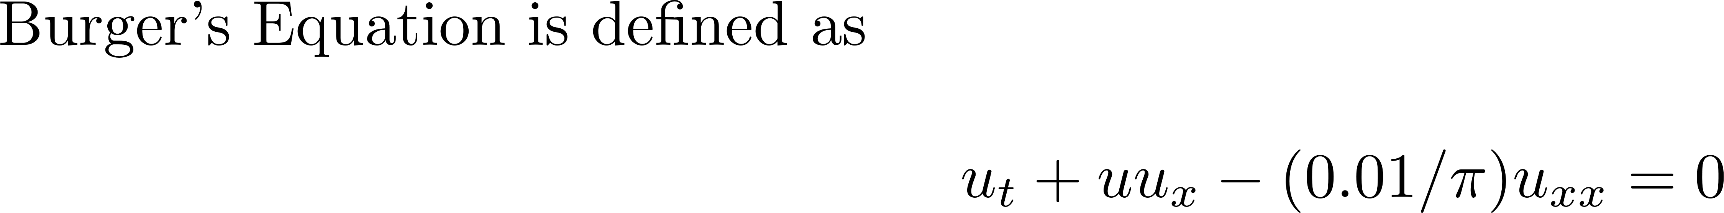
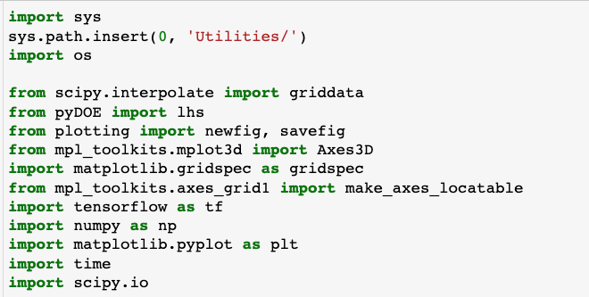
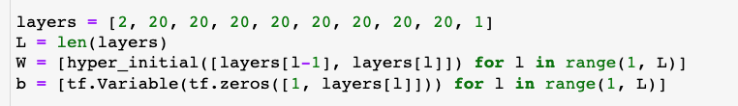
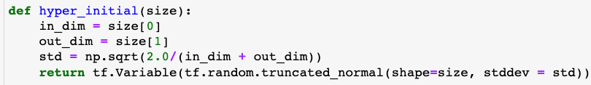
PINN for Burger’s Equation: Implementation
1. Import Modules and Deep Learning Framework
2a. Initialize Layers and NN Parameters
2b. Glorot Normal Initialization
Deep Learning for Scientists and Engineers, by George Em Karniadakis, Khemraj Shukla, Summer 2023 at KTH Stockholm
Notes:
RAJ

Slide 17
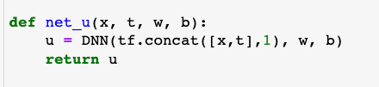
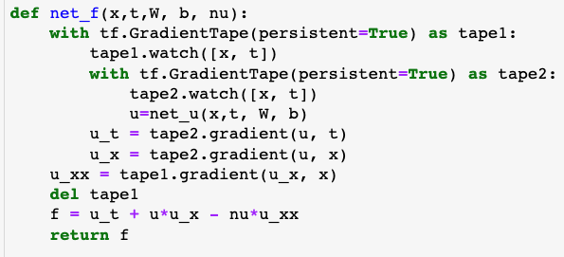
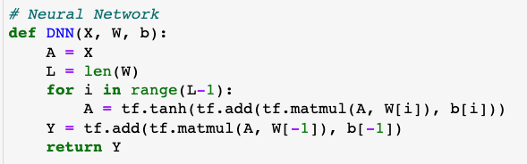
PINN for Burger’s Equation: Implementation
3a. Forward Pass
4. Residual Computation
3b. DNN Function:
Notes:
RAJ

Slide 18
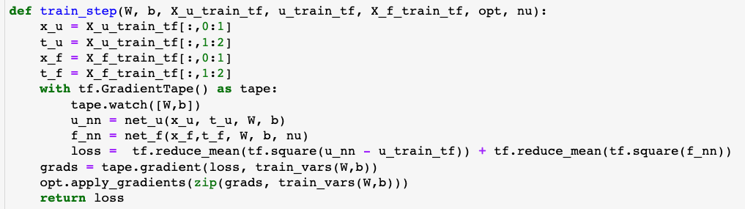
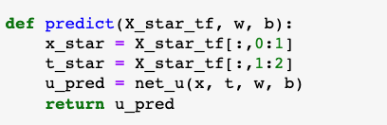
PINN for Burger’s Equation: Implementation
5. Backward Propagation
6. Predict
Notes:
RAJ

Slide 19
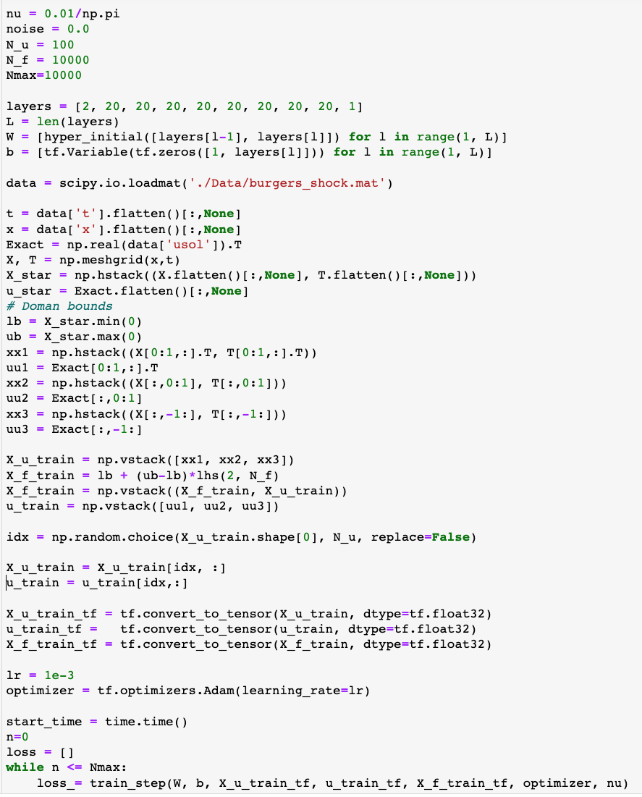
PINN for Burger’s Equation: Implementation
7. Data Preparation and Training
8. Optimizer and PINN Training
Notes:
RAJ

Slide 20
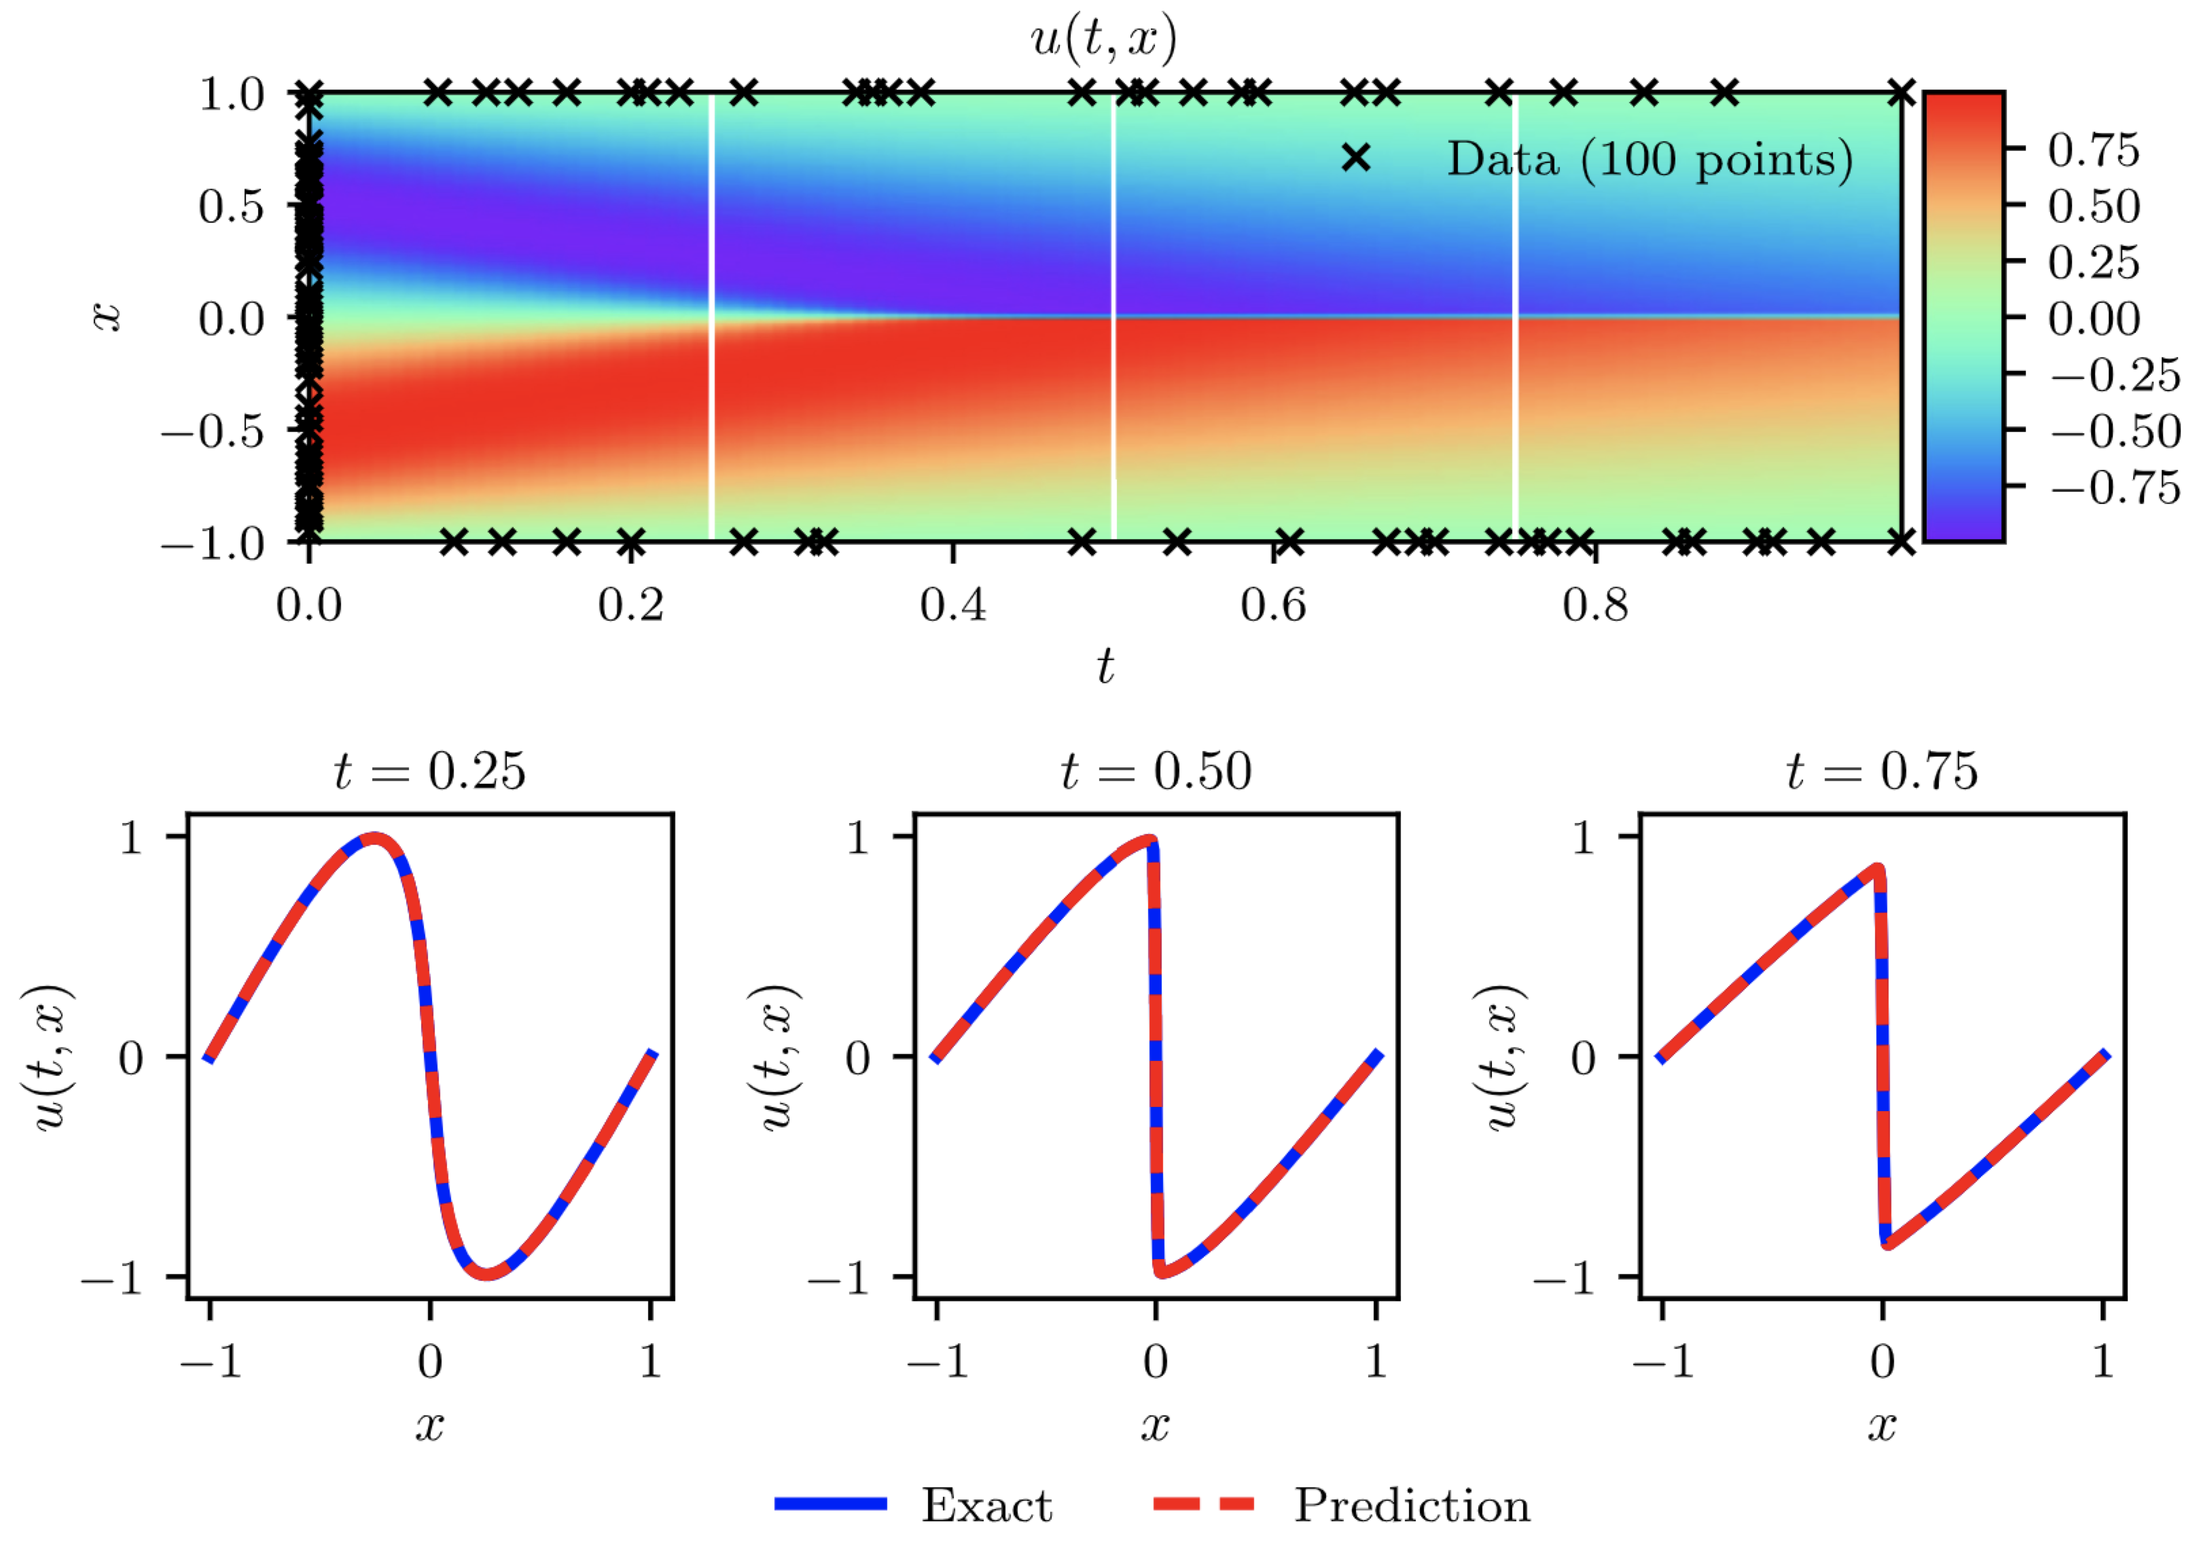
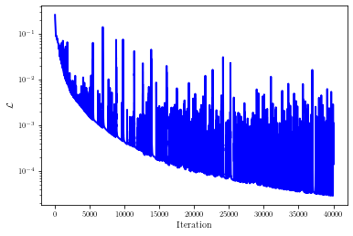
PINN for Burger’s Equation: Results
8. Actual vs Predicted Solutions at Different Times
9. Loss Function
Deep Learning for Scientists and Engineers, by George Em Karniadakis, Khemraj Shukla, Summer 2023 at KTH Stockholm
Notes:
Here is the solution to Burgers equation with gappy BC, a problem that cannot be solved at all using DG because of the gap in BC over large time periods. The loss function is shown on the right – further training is required ro
Obtain good generalization.

Slide 21
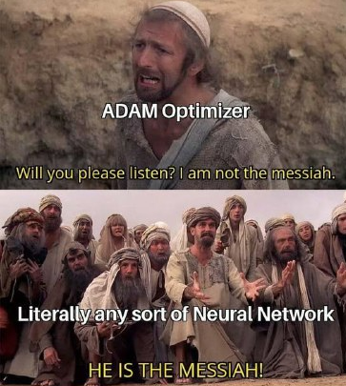
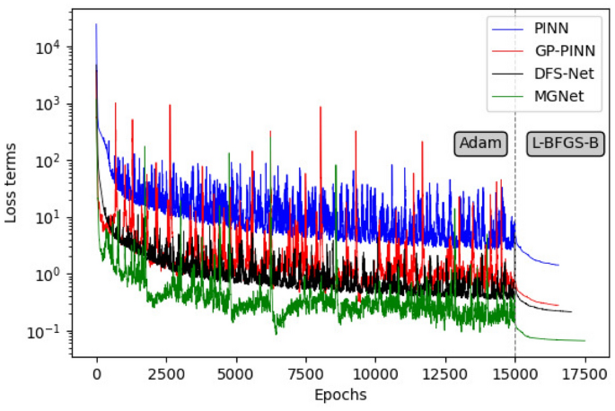
Optimization
When training PINNs, choosing the right optimizer is crucial.
Adam: Commonly used for PINNs due to its adaptive learning rate and robustness across various tasks.
L-BFGS: Second order optimizers like L-BFGS handle the high-dimensional, stiff optimization landscape in PINNs. They are often used in combination with Adam for final fine-tuning.

Slide 22
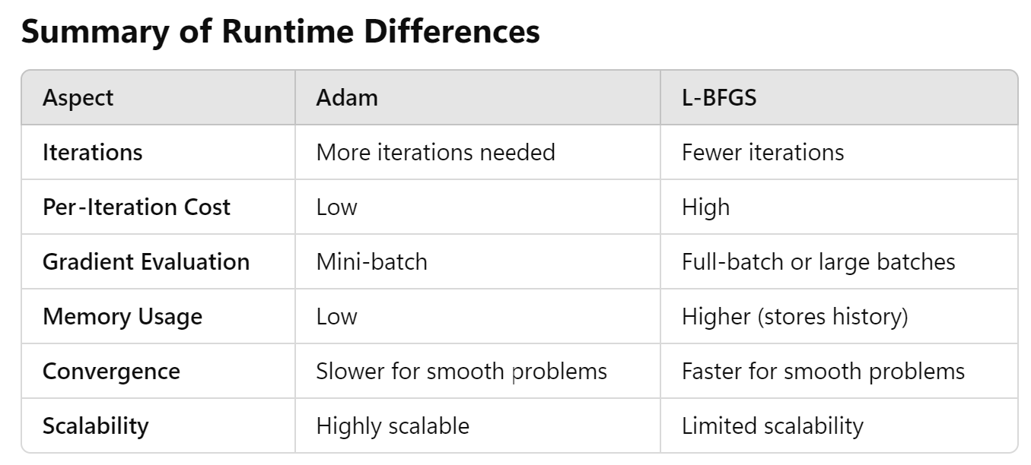
Optimization

Slide 23
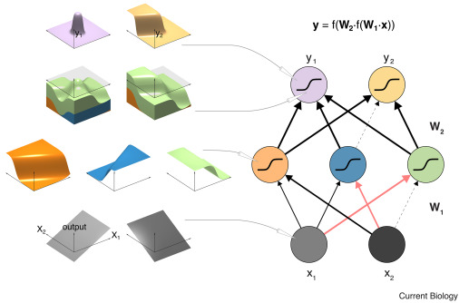
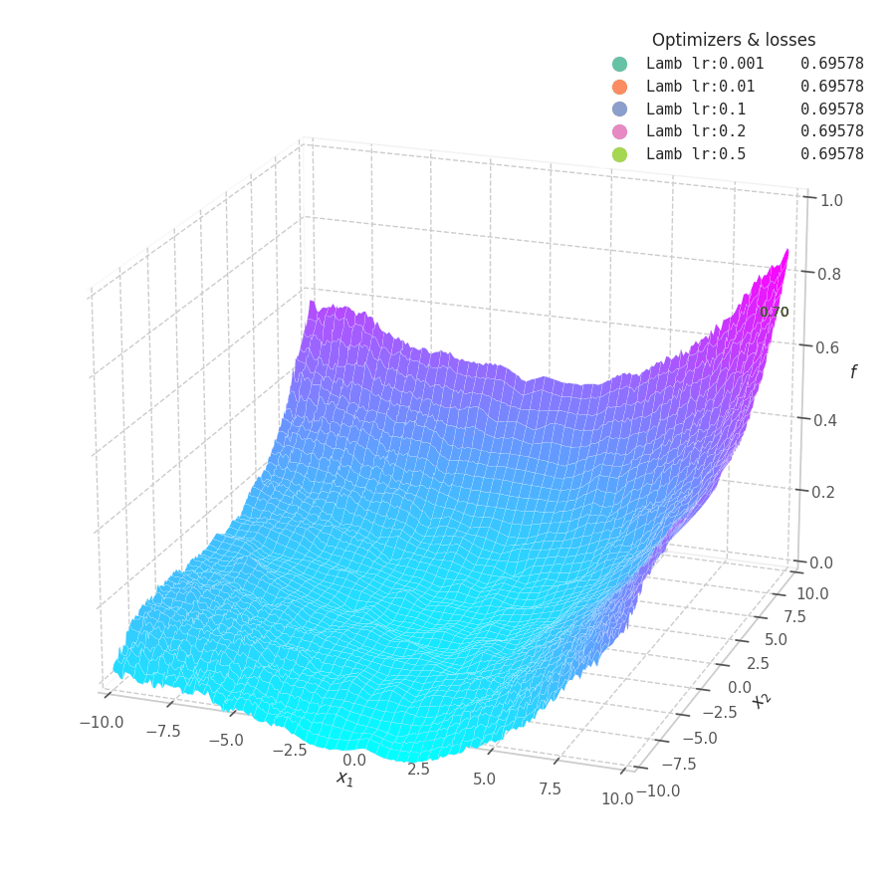
Why do we expect NNs to be helpful?
MLPs with non-linear activations are universal function approximators
However, they may require exponentially large number of neurons
The missing piece in universal approximation theorem is that it only considers approximation error, and not trainability and/or generalizability of the NN.
Neural network models and deep learning: Current Biology

Slide 24
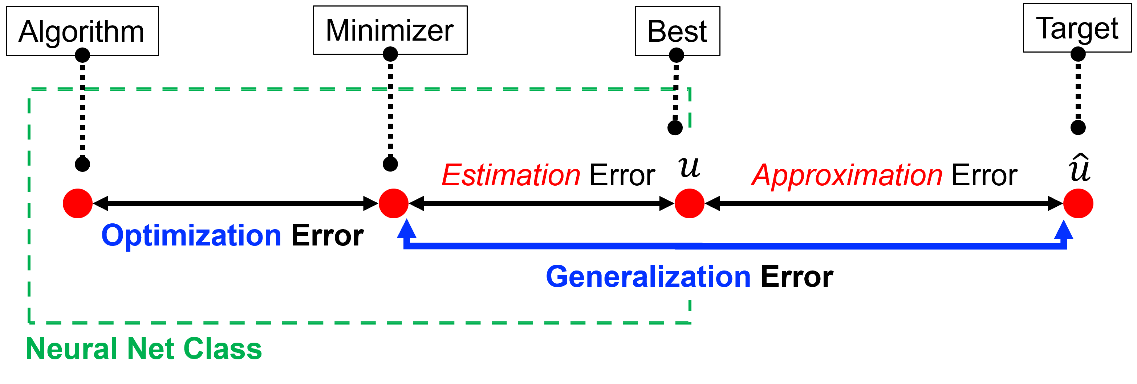
Error Decomposition
We can broadly characterize the accuracy of a NN into three main types:
Approximation Error: Model's inability to capture the true data distribution.
Optimization Error: Related to how well the optimization algorithm finds a suitable solution.
Estimation Error: Discrepancy between the true model and the learned model due to limited training data.
>> Generalization Error: Reflects model performance on unseen data, influenced by overfitting or underfitting.
Universal approximation theorem only considers the first one
It provides no method to train a model to get that approximation
Model
Optimizer
Check Optimizer
Use Better Data
Find Better Model
Data

Slide 25
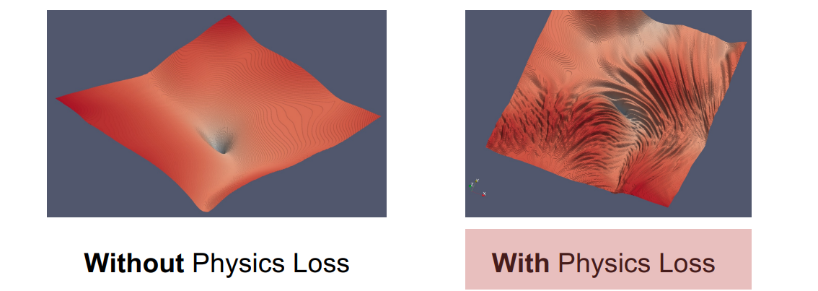
Training Challenges Optimization with PINNs
Krishnapriyan, A., Gholami, A., Zhe, S., Kirby, R., & Mahoney, M. W. (2021). Characterizing possible failure modes in physics-informed neural networks. Advances in neural information processing systems, 34, 26548-26560.
Interesting graphics: https://losslandscape.com/

Slide 26
Advantages / limitations of PINNs
Advantages Limitations
Mesh-free
Easy to implement
Can jointly solve forward and inverse problems
Often performs well on “messy” problems (where some observational data is available)
Tractable, analytical solution gradients (e.g. for sensitivity analysis)
Mostly unsupervised (to data)
Computational cost
Poor convergence
Scaling to more complex problems
AI in the Sciences and Engineering (2024), ETH Zurich, CAMLab

Slide 27

A short break

Slide 28



Variations of PINNs?
Conservative PINNs (cPINNs)
Extended PINNs (XPINNs)
Variational PINNs (VPINNs)
Stochastic PINNs (SPINNs)
Adaptive PINNs (APINNs)
Finite Basis PINNs (FBPINNs)
Augmented PINNs (A-PINNs)
Fourier PINNs (F-PINNs)
Bayesian PINNs (B-PINNs)

Slide 29



How to improve PINNs? Adaptive Loss Weighting
A technique designed to continuously adjust the weights of different terms in the loss function during the training.

Slide 30

How to improve PINNs? Adaptive Collocation Points
Adaptive collocation points in PINNs dynamically modifies the spatiotemporal placement of collocation points
It works either randomly, or based on the different criteria, such as solution's error estimates.

Slide 31

How to improve PINNs? Improved Network Architecture

Slide 32




How to improve PINNs? Normalized Mathematics / Changing Coordinates
Different studies have proven the performance of PINNs can be significantly improved if the dimensionless forms of PDEs are applied to define residual loss of the system
$$∂_{T}S_{n}=∂_{X}\left(Λ_{n}\left(S_{n}\right)∂_{X}S_{n}\right)$$
$$∂_{Z}S_{n}=−\frac{2}{Z}∂_{Z}\left(Λ_{n}\left(S_{n}\right)∂_{Z}S_{n}\right)$$
$$∂_{Y}S_{n}=2Y∂_{X}\left(Λ_{n}\left(S_{n}\right)∂_{X}S_{n}\right)$$
Abbasi et. al., 2023, https://pubs.acs.org/doi/full/10.1021/acs.energyfuels.3c02271
Y$=T^{0.5}$
$$Z=X/{T^{0.5}}$$

Slide 33


How to improve PINNs? Respecting Causality
Causality in PINNs refers to the principle that the solution of time-dependent PDEs should respect the natural temporal order of events.
In other words, the state of a system at a given time should preferably depend on its past states and not on future states.
Wang et al., 2021, RESPECTING CAUSALITY IS ALL YOU NEED FOR TRAINING PHYSICS-INFORMED NEURAL NETWORKS

Slide 34

How to improve PINNs? Curriculum Learning
An advanced training strategy that aims to improve the performance and convergence of PINNs, especially when dealing with more complex systems of PDEs.
The idea is to start training the network on easier version of the problem before gradually introducing more challenging aspects of the problem
2109.01050
Abbasi et al., 2024, https://arxiv.org/abs/2410.20801

Slide 35

How to improve PINNs? Sequence-to-sequence learning [seq2seq]
In contrast to regular PINN training, the solution in seq2seq learning is predicted for only one ∆t step at a time. Then, the predicted solution at t = ∆t is used as the initial condition for the next segment
Characterizing possible failure modes in physics-informed neural networks, https://arxiv.org/abs/2109.01050

Slide 36

And many more…

Slide 37


Moving Forward
PINNs is just one of the first techniques for physics based neural calculations.
e.g.,
ODIL (Optimizing a Discrete Loss) - https://github.com/cselab/odil
Hybrid Methods (Neural-Numerical Integration)
Physics-informed Convolutional Neural Networks (PICNN)
…

Slide 38
Thank You For Your Attention!
* Showing the loss-landscape during training a PINNs model!

